Slide 1
Superscalar Architecture (SSA)
Matthew McMillian
mgm160130

Slide 2
What is Superscalar Architecture?
Superscalar Architecture is a type of architecture that is designed to improve the performance and execution of scalar instructions. Scalar instructions include, but are not limited to:
Any variable that holds only one atomic value at a time (Integer)
Any process that processes one data item at a time
In a Superscalar System, several scalar instructions can be initialized simultaneously (in parallel) and executed independently through various methods such as pipelining, but you can also execute several instruction in the same pipelining phase, allowing for even faster execution times. This is called Instruction-Level Parallelism.

Slide 3
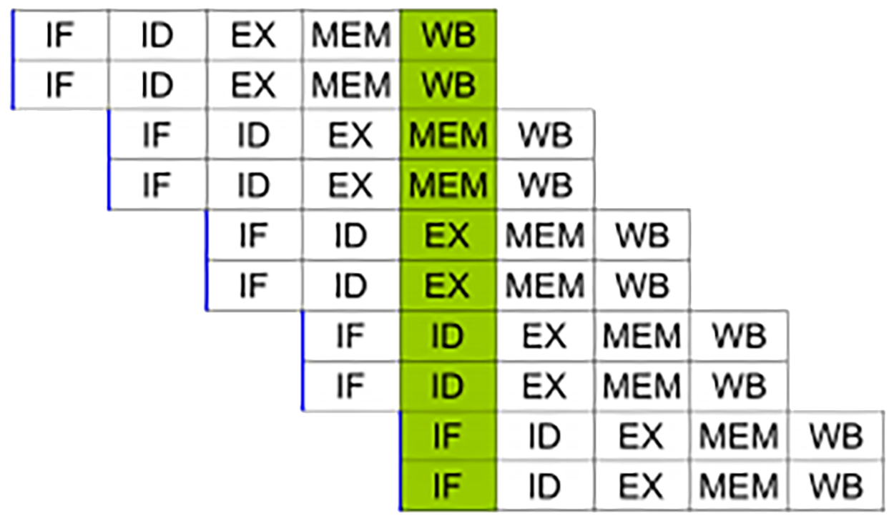
Why Should We Care?
Most operations are on scalar quantities (about 80% according to Zebo Pang). Increasing performance in this area will lead to a huge increase in the overall performance of the system.
Eliminates unnecessary dependencies by use of additional registers and renaming of register references.
Simple superscalar pipeline. By fetching and dispatching two instructions at a time, a maximum of two instructions per cycle can be completed.

Slide 4
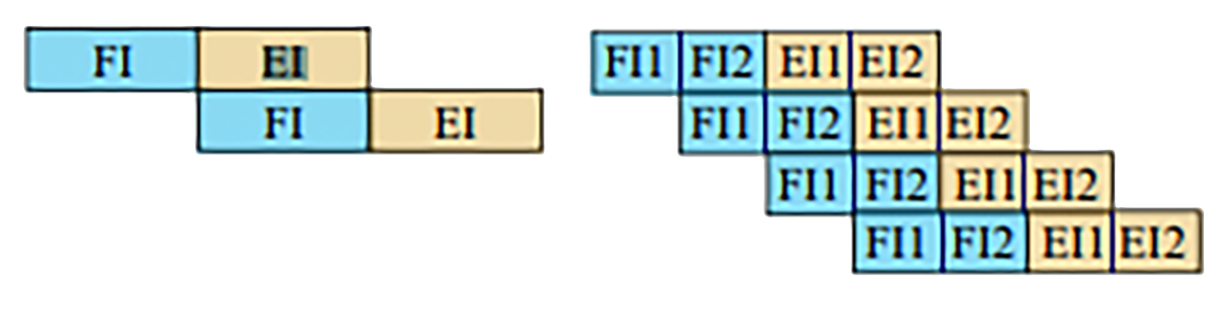
Types of SSA: Superpipelining
Superpipelining divides the stages of a normal pipeline into several sub-stages, increasing the number of instructions that are handled at each stage. If you were to divide each stage into two sub-stages, the pipeline can perform at twice of the original speed. This amount increases by 2x each time you split the piping phase without extra hardware.
Benefits Include:
Several Instructions per Clock Cycle
Parallel Instruction Handling
2 Hardware Resources Needed 4 Hardware Resources Needed

Slide 5
Limitations of Parallel Execution
Dubbed ‘pipeline hazards’, there are some issues that prevent efficient execution in pipelined architecture.
Resource Hazards (When branches are too close to be handled correctly in the pipeline)
Control Dependency (when an instruction is dependent on the execution of a previous instruction)
Data Dependencies (when an instruction depends on the result of a previous instruction).
Hazards in SSA are particularly dangerous, as obstructions to the parallelisms could amount in a large performance loss.

Slide 6

Limitations: Resource Hazards
Resource Conflicts occur when several instructions compete for the same hardware resource at the same time. i.e., two instructions need the same unit for execution. Sometimes this is also known as structural hazards in pipelines.
Thankfully, resource hazards can be partially solved by introducing several hardware units for the same functions i.e., a processor may have two floating point units for floating point calculations

Slide 7
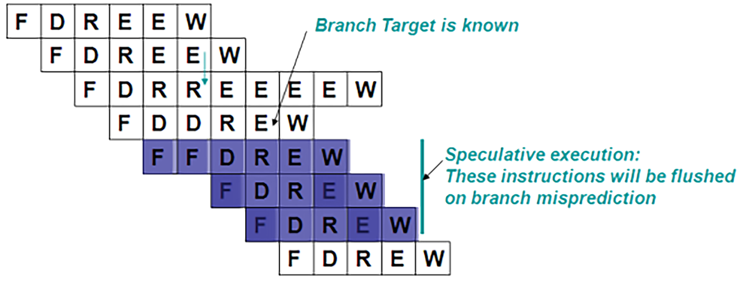
Limitations: Control Dependencies
Also known as procedural dependencies, these dependencies are typically caused by the presence of branches while trying to assure optimal parallelism. This is also similar to control hazards in pipelines.
If an instruction’s length isn’t CONST, they cannot be fetched and used in parallel since an instruction has to be decoded. This means that Superpipelining is efficient for instructions with a fixed length and format.

Slide 8
Limitations: Data Dependencies

